Slide 1
Computer Security: Principles and Practice
Lawrie Brown and William Stallings
EECS710: Information Security
Professor Hossein Saiedian
Fall 2014
Chapter 7: Denial-of-Service Attacks
Notes:
Lecture slides prepared by Dr Lawrie Brown (UNSW@ADFA) for “Computer Security: Principles and Practice”, 1/e, by William Stallings and Lawrie Brown, Chapter 1 “Overview”.

Slide 2
Denial-of-service
Denial of service (DoS) an action that prevents or impairs the authorized use of networks, systems, or applications by exhausting resources such as central processing units (CPU), memory, bandwidth, and disk space
Attacks (overload or invalid request services that consume significant resources)
  network bandwidth
  system resources
  application resources
Have been an issue for some time (25% of respondents to an FBI survey)
Notes:
This chapter explores denial of service attacks, their definition, the various forms they take, and defenses against them. Denial of service is a form of attack on the availability of some service. In the context of computer and communications security, the focus is generally on network services that are attacked over their network connection. From this definition you can see that there are several categories of resources that could be attacked:
• network bandwidth - relates to the capacity of the network links connecting a server to the wider Internet
• system resources - typically aims to overload or crash its network handling software
• application resources - aim to overload the capabilities of a server and limit its ability to respond to requests from other users
Denial of Service attacks have been a problem for many years. The 2006 CSI/FBI Computer Crime and Security Survey states that 25% of respondents experienced some form of denial of service attack in the previous 12 months. This value has varied between 25% and 40% over the previous 8 years of surveys.

Slide 3
Classic DoS attacks
Flooding ping command
  Aim of this attack is to overwhelm the capacity of the network connection to the target organization
  Traffic can be handled by higher capacity links on the path, but packets are discarded as capacity decreases
Source of the attack is clearly identified unless a spoofed address is used
Network performance is noticeably affected

Slide 4
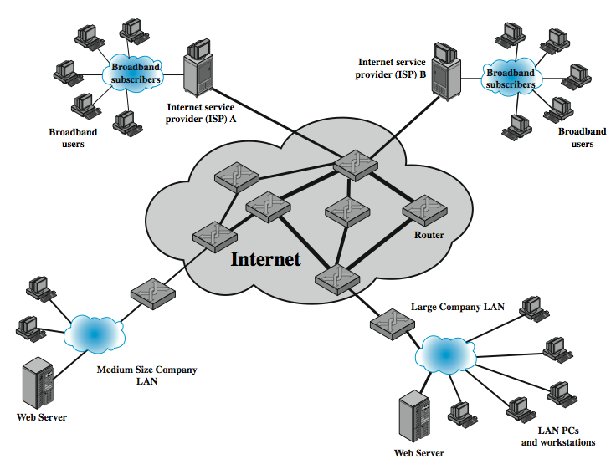
Classic DoS attacks
Notes:
For example, in the network shown in Figure 8.1, the attacker might use the large company’s web server to target the medium sized company with a lower capacity network connection.

Slide 5
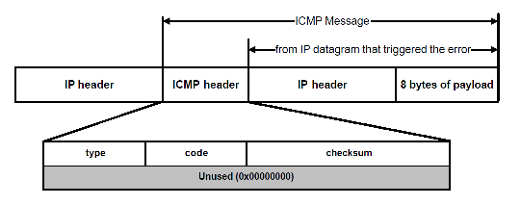
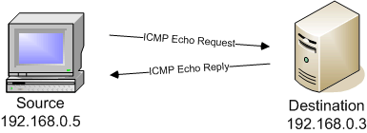
Internet Control Message Protocol (ICMP)
The Internet Control Message Protocol (ICMP) is one of the main IP protocols; it is used by network devices, like routers, to send error messages indicating (e.g., a requested service is not available or a host or router could not be reached)
The host must respond to all echo requests with an
echo reply containing the exact data received in the
request message

Slide 6
Source address spoofing
Use forged source addresses
  Usually via the raw socket interface on operating systems
  Makes attacking systems harder to identify
Attacker generates large volumes of packets that have the target system as the destination address
Congestion would result in the router connected to the final, lower capacity link
Backscatter traffic
  Advertise routes to unused IP addresses to monitor attack traffic
Notes:
A common characteristic of packets used in many types of denial of service attacks, is the use of forged source addresses. This is known as source address spoofing. Given sufficiently privileged access to the network handling code on a computer system, it is easy to create packets with a forged source address (and indeed any other attribute that is desired). Given raw access to the network interface, the attacker now generates large volumes of packets. These would all have the target system as the destination address, but use randomly selected, usually different, source addresses for each packet. These packets would flow over the same path from the source towards the target system. The same congestion would result in the router connected to the final, lower capacity link. However the response packets, generated in response to those packets reaching the target system, would no longer be reflected back to the source system. Rather they would be scattered across the Internet to all the various forged source addresses. Some of these addresses might correspond to real systems, others may not be used, or not reachable. As well, the use of packets with forged source addresses means the attacking system is much harder to identify. The attack packets seem to have originated at addresses scattered across the Internet. Hence just inspecting each packet’s header is not sufficient to identify its source. Rather the flow of packets of some specific form through the routers along the path from the source to the target system must be identified.

Slide 7
Backscatter traffic
Security researchers (Honeypot Project) advertise blocks of unused IP addresses (no real/legit uses)
If ICMP/connection request is made, most likely from attackers
Monitoring provides valuable info on the type and scale of attack

Slide 8
SYN spoofing
Common DoS attack
Attacks the ability of a server to respond to future connection requests by overflowing the tables used to manage them
Thus legitimate users are denied access to the server
Hence an attack on system resources, specifically the network handling code in the operating system
Notes:
Along with the basic flooding attack, the other common classic denial of service attack is the SYN spoofing attack. This attacks the ability of a network server to respond to TCP connection requests by overflowing the tables used to manage such connections. This means future connection requests from legitimate users fail, denying them access to the server. It is thus an attack on system resources, specifically the network handling code in the operating system.

Slide 9
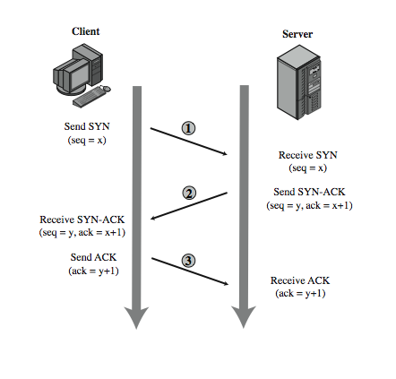
TCP connection handshake
syn/ack pkts
y= server seq#
x= client seq#
Notes:
To understand the operation of these attacks we need to review the 3-way handshake that TCP uses to establish a connection. This is illustrated in Figure 8.2. The client system initiates the request for a TCP connection by sending a SYN packet to the server. This identifies the client’s address and port number, and supplies an initial sequence number. The server records all the details about this request in a table of known TCP connections. It then responds to the client with a SYN-ACK packet. This includes a sequence number for the server, and increments the client’s sequence number to confirm receipt of the SYN packet. Once the client receives this it sends an ACK packet to the server with an incremented server sequence number, and marks the connection as established. Likewise, when the server receives this ACK packet it also marks the connection as established. Either party may then proceed with data transfer. In practice, this ideal exchange sometimes fails. These packets are transported using IP, which is an unreliable, though best-effort, network protocol. Any of the packets might be lost in transit, as a result of congestion for example. Hence both the client and server keep track of which packets they have sent, and if no response is received in a reasonable time, will resend those packets. As a result, TCP is a reliable transport protocol, and any applications using it need not concern themselves with problems of lost or reordered packets.

Slide 10
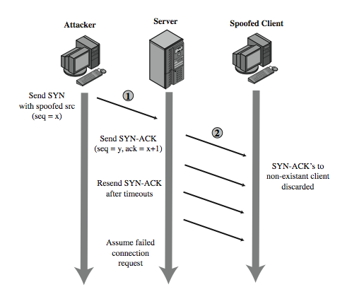
SYN spoofing attack
assumption: most connections succeed and thus table cleared quickly
Notes:
A SYN spoofing attack exploits this behavior on the targeted server system. The attacker generates a number of SYN connection request packets with forged source addresses. For each of these the server records the details of the TCP connection request, and sends the SYN-ACK packet to the claimed source address, as shown in Figure 8.3. The server will resend the SYN-ACK packet a number of times before finally assuming the connection request has failed, and deleting the information saved concerning it. This table is typically sized on the assumption that most connection requests quickly succeed, and that a reasonable number of requests may be handled simultaneously. However in a SYN spoofing attack, the attacker directs a very large number of forged connection requests at the targeted server. These rapidly fill the table of known TCP connections on the server. Once this table is full, any future requests, including legitimate requests from other users, are rejected. The table entries will time out and be removed, which in normal network usage, corrects temporary overflow problems. However, if the attacker keeps a sufficient volume of forged requests flowing, this table will be constantly full and the server will be effectively cutoff from the Internet, unable to respond to most legitimate connection requests.

Slide 11
SYN spoofing attack: attacker’s source
Attacker often uses either
  random source addresses (addresses that may not exist)
  or that of an overloaded server (that may not send a RST)
  to block return of (most) reset packets
Has much lower traffic volume
  attacker can be on a much lower capacity link
Objective: uses addresses that will not respond to the SYN-ACK with a RST
Notes:
In order to increase the usage of the known TCP connections table, the attacker ideally wishes to use addresses that will not respond to the SYN-ACK with a RST. This can be done by overloading the host that owns the chosen spoofed source address, or by simply using a wide range of random addresses. In this case, the attacker relies on the fact that there are many unused addresses on the Internet. Consequently a reasonable proportion of randomly generated addresses will not correspond to a real host.
There is a significant difference in the volume of network traffic between a SYN spoof attack, and the basic flooding attack we discussed. The actual volume of SYN traffic can be comparatively low, nowhere near the maximum capacity of the link to the server. It simply has to be high enough to keep the known TCP connections table filled. Unlike the flooding attack, this means the attacker does not need access to a high volume network connection. In the network shown in Figure 8.1, the medium sized organization, or even a broadband home user, could successfully attack the large company server using a SYN spoofing attack.

Slide 12
Types of flooding attacks
Classified based on network protocol used
Objective: to overload the network capacity on some link to a server
Virtually any type of network packet can be used
ICMP Flood
  Uses ICMP packets, eg ping (echo) request
  Typically allowed through, some required
UDP Flood
  Alternative uses UDP packets to random ports (even if no service is available, attacker achieves its goal)
TCP SYN Flood (SYN spoof vs SYN flood)
  Sends TCP SYN (connection request) packets
  But for volume attack
Notes:
Flooding attacks take a variety of forms, based on which network protocol is being used to implement the attack. Common flooding attacks use any of the ICMP, UDP or TCP SYN packet types.
An ICMP flooding attack uses an ICMP packet, such as ICMP echo request packets in a ping flood. This type of ICMP packet was chosen since traditionally network administrators allowed such packets into their networks. More recently, many organizations have restricted the ability of these packets to pass through their firewalls. In response, attackers have started using other ICMP packet types. Since some of these should be handled to allow the correct operation of TCP/IP, they are much more likely to be allowed through an organization’s firewall.
An alternative to using ICMP packets is to use UDP packets directed to some port number, and hence potential service, on the target system. Spoofed source addresses are normally used if the attack is generated using a single source system, for the same reasons as with ICMP attacks.
Another alternative is to send TCP packets to the target system. Most likely these would be normal TCP connection requests, with either real or spoofed source addresses. In this case, it is the total volume of packets that is the aim of the attack, rather than specifically targeting the system code. This is the difference between a SYN spoofing attack and a SYN flooding attack.

Slide 13
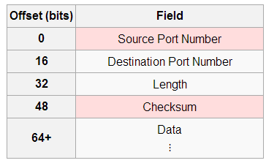
UDP packet
User Datagram Protocol (UDP) is a component of the IP suite and allows computer applications to send messages
A UDP can be directed at practically any service (port); if service is unavailable, the packet is discarded but the attacker objective is achieved

Slide 14
Distributed DoS attacks
Have limited volume if single source used
Multiple systems allow much higher traffic volumes to form a distributed DoS (DDoS) attack
Often compromised PC’s/workstations
  Zombies with backdoor programs installed
  Forming a botnet
Example: Tribe Flood Network (TFN), TFN2K
  did ICMP, SYN, UDPF and ICMP floods
Notes:
All of these flooding attack variants are limited in the total volume of traffic that can be generated if just a single system is used to launch the attack. By using multiple systems, the attacker can significantly scale up the volume of traffic that can be generated. Each of these systems need not be particularly powerful, or on a high capacity link. But what they don’t have individually, they more than compensate for in large numbers. These systems were typically compromised user workstations or PC’s. The attacker used some well-known flaw in the operating system or in some common application, to gain access to these systems, and to install their own programs on it. Such systems are known as “zombies”. Once suitable “backdoor” programs were installed on these systems, they were entirely under the attacker’s control. Large collections of such systems under the control of one attacker can be created, collectively forming a “botnet”. One of the earliest and best known DDoS tools is Tribe Flood Network (TFN), written by the hacker known as Mixter. The original variant from the 1990’s exploited Sun Solaris systems. It was later rewritten as Tribe Flood Network 2000 (TFN2K), and could run on UNIX, Solaris, and Windows NT systems. The agent was a Trojan program that was copied to, and run on compromised, zombie systems. It was capable of implementing ICMP flood, SYN flood, UDP flood, and ICMP amplification forms of denial of service attacks.

Slide 15
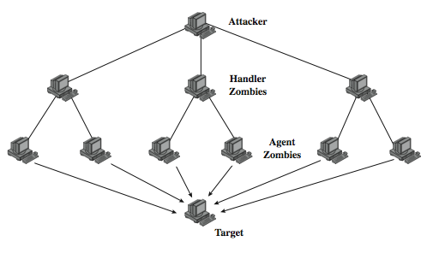
DDoS control hierarchy
Attacker sends one command to the handler zombies;
the handler forwards to other handlers, agents
Notes:
Whilst the attacker could command each zombie individually, more generally a control hierarchy is used. A small number of systems act as handlers controlling a much larger number of agent systems, as shown in Figure 8.4. There are a number of advantages to this arrangement. The attacker can send a single command to a handler, which then automatically forwards it to all the agents under its control. Automated infection tools can also be used to scan for and compromise suitable zombie systems. Once the agent software is uploaded to a newly compromised system, it can contact one or more handlers to automatically notify them of its availability. By this means, the attacker can automatically grow suitable “botnets”. TFN and TFN2K use a version of this two-layer command hierarchy.
The best defense against being an unwitting participant in a DDoS attack is to prevent your systems from being compromised. For the target of a DDoS attack, the response is the same as for any flooding attack, but with greater volume and complexity.

Slide 16
Application-based bandwidth attacks
Force the victim system to execute resource-consuming operations (e.g., searches, complex DB queries)
VoIP Session Initiation Protocol (SIP) flood (see Figure 7.5): attacker sends many INVITE requests; major burden on the proxies
  server resources depleted while handling requests
  bandwidth capacity is consumed

Slide 17
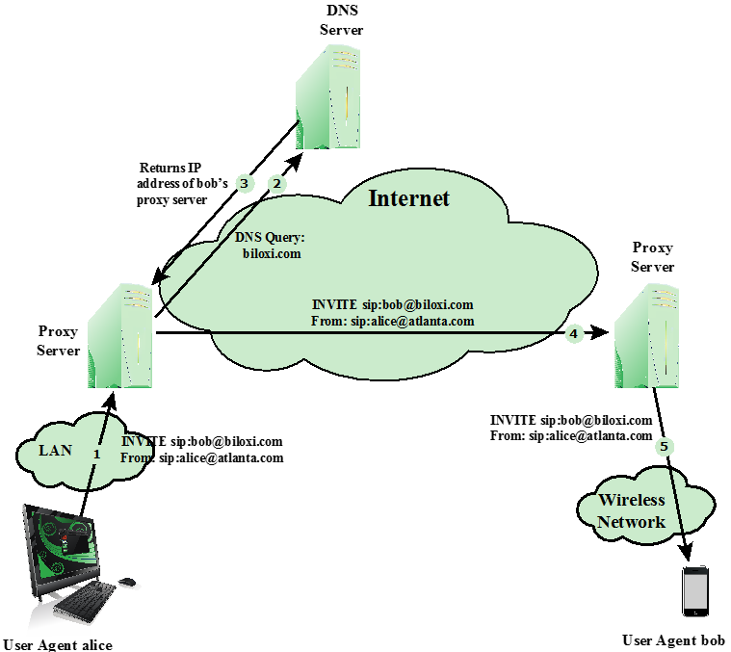
SIP invite scenario
Standard protocol for VoIP telephony
Text-based protocol with a syntax similar to that of HTTP
Two types of SIP messages: requests and responses

Slide 18
HTTP-based attacks
Attempts to monopolize by sending HTTP requests that never complete
Eventually consumes Web server’s connection capacity
Utilizes legitimate HTTP traffic
Spidering: Bots starting from a given HTTP link and following all links on the provided Web site in a recursive way
Existing intrusion detection and prevention solutions that rely on signatures to detect attacks will generally not recognize Slowloris

Slide 19
Reflection attacks
Attacker sends packets to a known service on the intermediary with a spoofed source address of the actual target system
When intermediary responds, the response is sent to the target
“Reflects” the attack off the intermediary (reflector)
Goal is to generate enough volumes of packets to flood the link to the target system without alerting the intermediary
The basic defense against these attacks is blocking spoofed-source packets
Notes:
Reflection and amplification attacks use network systems functioning normally. The attacker sends a network packet with a spoofed source address to a service running on some network server, which responds to this packet, sending it to the spoofed source address that belongs to the actual attack target. If the attacker sends a number of requests to a number of servers, all with the same spoofed source address, the resulting flood of responses can overwhelm the target’s network link. The fact that normal server systems are being used as intermediaries, and that their handling of the packets is entirely conventional, means these attacks can be easier to deploy, and harder to trace back to the actual attacker. Ideally the attacker would like to use a service that created a larger response packet than the original request. This allows the attacker to convert a lower volume stream of packets from the originating system into a higher volume of packets from the intermediary directed at the target. Common UDP services are often used for this purpose. Another variant of reflection attack uses TCP SYN packets, and exploits the normal 3-way handshake used to establish a TCP connection. Fundamental to the success of reflection attacks is the ability to create source spoofed packets. If filters are in place which block source spoofed packets, then these attacks are simply not possible.

Slide 20
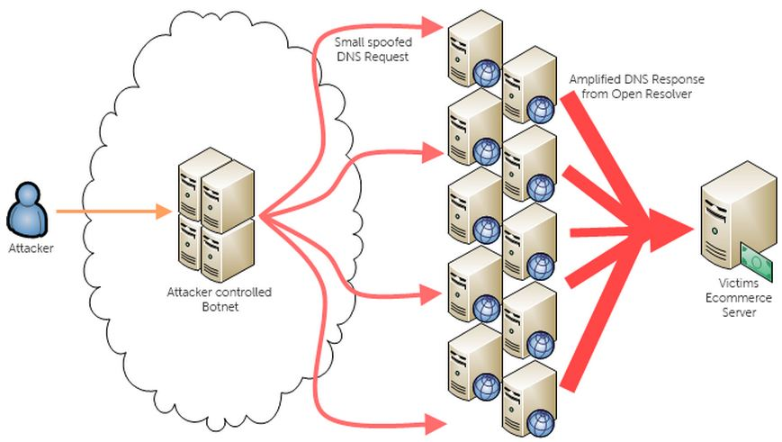
Reflection attacks

Slide 21
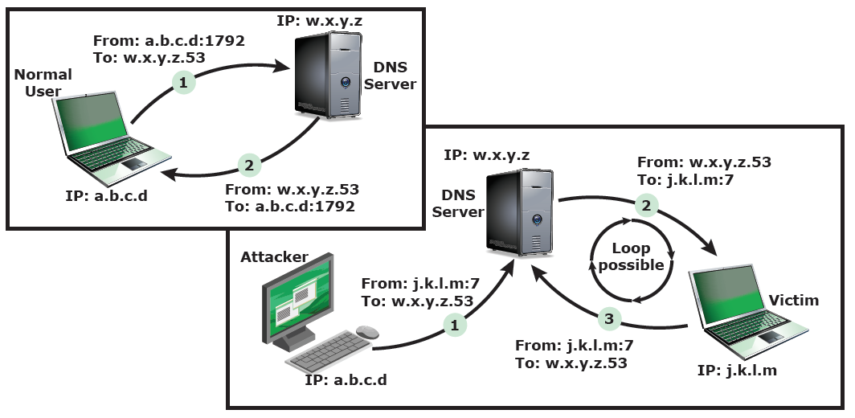
Reflection attacks
Further variation creates a self-contained loop between intermediary and target (attacker spoofs using port 7 requiring echoes)
Fairly easy to filter and block
Notes:
A further variation of the reflector attack establishes a self-contained loop between the intermediary and the target system. Originally the UDP echo service was used for this, if running on both systems. The attacker would send a large UDP packet to the echo service on the intermediary, using a spoofed source address and port for the echo service on the target system. The intermediary would respond with a packet to the echo service on the target. When the target received this, it would reply in turn to the intermediary. This process would continue with the packet being echoed back and forth between these systems, until a packet was discarded or otherwise failed to arrive at its destination. If the attacker kept generating a low volume of the original source spoofed packets, this attack could be sustained for long periods, flooding the link between the intermediary and the target. The echo and chargen services, and other similar diagnostic network services can be used to create such reflection loops. Figure 8.5 illustrates this attack. Whilst very effective if possible, this type of attack is fairly easy to filter for, since the combinations of service ports used should never occur in normal network operation.

Slide 22
DNS reflection attacks

Slide 23
DNS amplification attacks
Use packets directed at a legitimate DNS server as the intermediary system
Attacker creates a series of DNS requests containing the spoofed source address of the target system
Exploit DNS behavior to convert a small request to a much larger response (amplification)
Target is flooded with responses
Basic defense against this attack is to prevent the use of spoofed source addresses
Notes:
A further variant of a reflection or amplification attack uses packets directed at a legitimate DNS server as the intermediary system. They gain attack amplification by exploiting the behavior of the DNS protocol to convert a small request into a much larger response. Using the classic DNS protocol, a 60 byte UDP request packet can easily result in a 512 byte UDP response, the maximum traditionally allowed. More recently, the DNS protocol has been extended to allow much larger responses of over 4000 bytes, to support extended DNS features such as IPv6, security, and others. By targeting servers that support the extended DNS protocol, significantly greater amplification can be achieved than with the classic DNS protocol.
In this attack, a selection of suitable DNS servers with good network connections, are chosen. The attacker creates a series of DNS requests containing the spoofed source address of the target system. These are directed at a number of the selected name servers. They respond to these requests, sending the replies to the spoofed source, which appears to them to be the legitimate requesting system. The target is then flooded with their responses. Because of the amplification achieved, the attacker need only generate a moderate flow of packets to cause a larger, amplified flow to flood and overflow the link to the target system. Whilst the intermediate systems will also experience significant loads, by using a number of high capacity, well connected systems, the attacker can ensure they are not overloaded, allowing the attack to proceed.

Slide 24
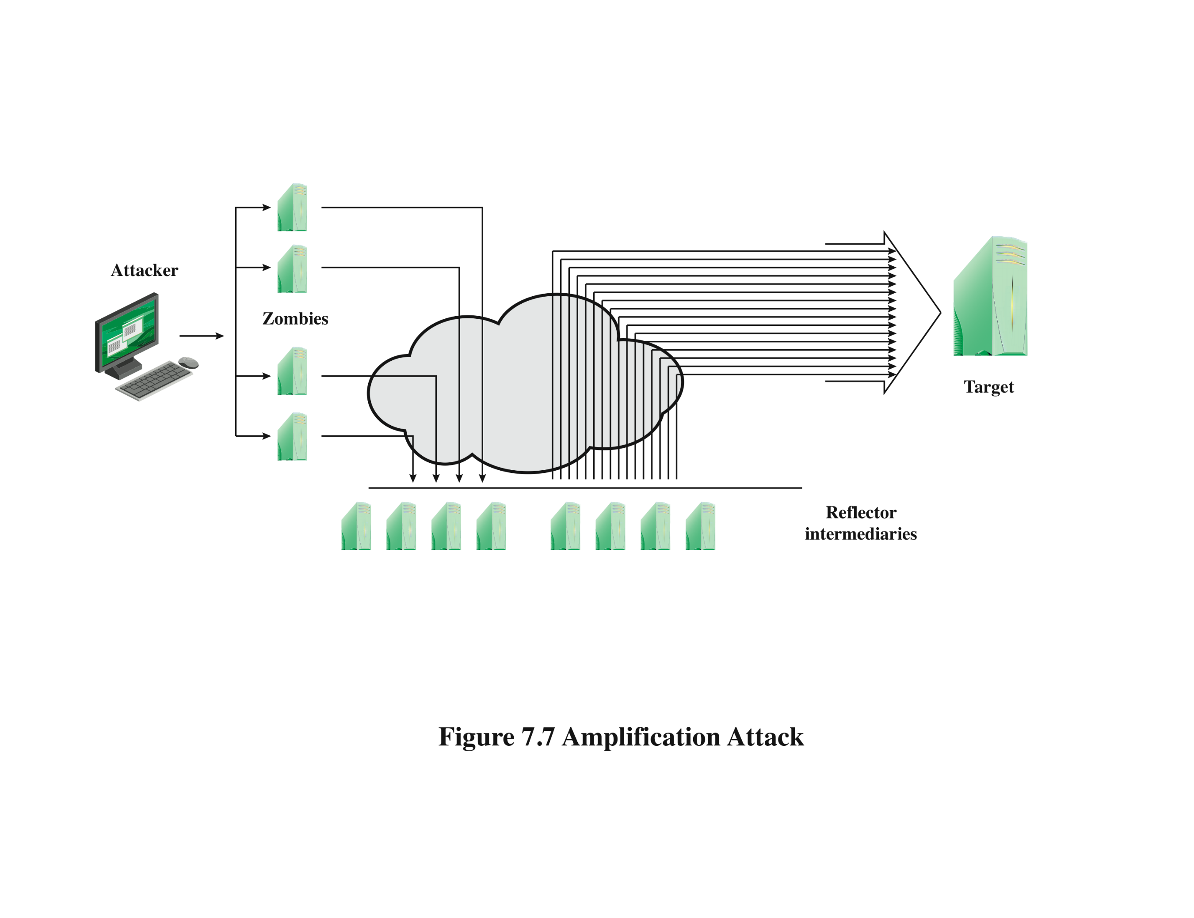
Amplification attacks
Can take advantage of broadcast address of some network
Notes:
Amplification attacks are a variant of reflector attacks and also involve sending a
packet with a spoofed source address for the target system to intermediaries. They
differ in generating multiple response packets for each original packet sent. This can
be achieved by directing the original request to the broadcast address for some network.
As a result, all hosts on that network can potentially respond to the request,
generating a flood of responses as shown in Figure 7.7 . It is only necessary to use
a service handled by large numbers of hosts on the intermediate network. A ping
flood using ICMP echo request packets was a common choice, since this service
is a fundamental component of TCP/IP implementations and was often allowed
into networks. The well-known smurf DoS program used this mechanism and was
widely popular for some time. Another possibility is to use a suitable UDP service,
such as the echo service. The fraggle program implemented this variant. Note that
TCP services cannot be used in this type of attack; because they are connection
oriented, they cannot be directed at a broadcast address. Broadcasts are inherently
connectionless.
The best additional defense against this form of attack is to not allow directed
broadcasts to be routed into a network from outside. Indeed, this is another longstanding
security recommendation, unfortunately about as widely implemented as
that for blocking spoofed source addresses. If these forms of filtering are in place,
these attacks cannot succeed. Another defense is to limit network services like echo
and ping from being accessed from outside an organization. This restricts which
services could be used in these attacks, at a cost in ease of analyzing some legitimate
network problems.
Attackers scan the Internet looking for well-connected networks that do allow
directed broadcasts and that implement suitable services attackers can reflect off.
These lists are traded and used to implement such attacks.

Slide 25
Four lines of defense against DDoS attacks
Attack prevention and preemption (before attack)
Attack detection and filtering (during the attack)
Attack source traceback and identification (uring and after the attack)
Attack reaction (after the attack)

Slide 26
DoS attack prevention
Block spoofed source addresses
  On routers as close to source as possible
Filters may be used to ensure path back to the claimed source address is the one being used by the current packet
  Filters must be applied to traffic before it leaves the ISP’s network or at the point of entry to their network
Use modified TCP connection handling code
  Cryptographically encode critical information in a cookie that is sent as the server’s initial sequence number
  Legitimate client responds with an ACK packet containing the incremented sequence number cookie
  Drop an entry for an incomplete connection from the TCP connections table when it overflows

Slide 27
Attack prevention
Rate controls in upstream distribution nets
  On specific packets types e.g. some ICMP, some UDP, TCP/SYN
  Impose limits
Use modified TCP connection handling
  Server sends SYN cookies when table full (reconstruct table data from the cookie from legit clients)
  Sr selective or random drop when table full
Notes:
A critical component of many denial of service attacks, is the use of spoofed source addresses. One of the fundamental, and longest standing, recommendations for defense against these attacks is to limit the ability of systems to send packets with spoofed source addresses, cf. RFC 2827. This filtering needs to be done as close to the source as possible, by routers or gateways knowing the valid address ranges of incoming packets. Typically this is the ISP providing the network connection for an organization or home user. Regrettably, despite this being a well-known recommendation, many ISPs still do not perform this type of filtering.
Any defenses against flooding attacks need to be located back in the Internet cloud, not at a target organization’s boundary router, since this is usually located after the resource being attacked. The filters must be applied to traffic before it leaves the ISP’s network, or even at the point of entry to their network. Some attacks using particular packet types, such as ICMP floods, or UDP floods to diagnostic services, can be throttled by imposing limits on the rate at which these packets will be accepted.
It is possible to specifically defend against the SYN spoofing attack by using a modified version of the TCP connection handling code. Instead of saving the connection details on the server, critical information about the requested connection is cryptographically encoded in a “cookie” that is sent as the server’s initial sequence number. Typically this technique is only used when the table overflows. Alternatively, the system’s TCP/IP network code can be modified to “selective drop” or “random drop” an entry for an incomplete connection from the TCP connections table when it overflows, allowing a new connection attempt to proceed.

Slide 28
Attack prevention
Block IP directed broadcasts
Block suspicious services and combinations
Manage application attacks with a form of graphical puzzle (captcha) to distinguish legitimate human requests
Use mirrored and replicated servers when high-performance and reliability is required
Notes:
The best defense against broadcast amplification attacks is to block the use of IP directed broadcasts. This can be done either by the ISP, or by any organization whose systems could potentially be used as an intermediary. As we noted earlier in this chapter, this along with anti-spoofing filters are long standing security recommendations that all organization’s ought to implement. More generally, limiting or blocking traffic to suspicious services, or combinations of source and destination ports, can restrict the types of reflection attacks that can be used against an organization.
Defending against attacks on application resources generally requires modification to the applications targeted, such as web servers. Defenses may involve attempts to identify legitimate, generally human initiated, interactions from automated DoS attacks. These often take the form of a “graphical puzzle”, which is easy for most humans to solve, but difficult to automate.
Beyond these direct defenses against denial of service attack mechanisms, overall good system security practices should be maintained. The aim is to ensure that your systems are not compromised and used as zombie systems. Suitable configuration and monitoring of high performance, well-connected servers, is also needed to help ensure they don’t contribute to the problem as potential intermediary servers.
If an organization is dependent on network services, they should consider mirroring and replicated these servers over multiple sites with multiple network connections. This is good general practice for high performance servers, providing greater levels of reliability and fault tolerance in general, not just as a response to these types of attack.

Slide 29
Responding to attacks
Good incidence response plan
  Details on how to contact technical personal for ISP
  Needed to impose traffic filtering upstream
  Details of how to respond to the attack
Implement anti-spoofing, directed broadcast, and rate limiting filters
Ideally have network monitors and IDS to detect and notify abnormal traffic patterns
Notes:
In order to successfully respond to a denial of service attack, a good incident response plan is needed, including details of how to contact technical personal for your Internet Service Provider(s). Denial of service attacks, particularly flooding attacks, can only be filtered upstream of your network connection. The plan should also contain details of how to respond to the attack. The division of responsibilities between organizational personnel and the ISP will depend on the resources available, and technical capabilities of the organization.
Within an organization you should have implemented the standard anti-spoofing, directed broadcast, and rate limiting filters we discuss earlier in this chapter. Ideally, you should also have some form of automated network monitoring and intrusion detection system (IDS) running, so personnel will be notified should abnormal traffic be detected.

Slide 30
Responding to attacks
Identify type of attack
  Capture and analyze packets
  Design filters to block attack traffic upstream
  Or identify and correct system/application bug
Have ISP trace packet flow back to source
  May be difficult and time consuming
  Necessary if planning legal action
Implement contingency plan
  Switch to alternate backup servers
  Commission new servers at a new site with new addresses
Update incident response plan
Notes:
When a denial of service attack is detected, the first step is to identify the type of attack and hence the best approach to defend against it. Typically this involves capturing packets flowing into the organization, and analyzing them looking for common attack packet types. This may be done by organizational personnel or ISP, depending on relevant expertise. From this analysis the type of attack is identified, and suitable filters designed to block the flow of attack packets. These have to be installed by the ISP on their routers. If the attack targets a bug on a system or application, rather than high traffic volumes, then this must be identified, and steps taken to correct it to prevent future attacks.
The organization may also wish to ask their ISP to trace the flow of packets back in an attempt to identify their source. However if spoofed sources addresses are used, this can be difficult and time-consuming. Whether this is attempted may well depend on whether the organization intends to report the attack to the relevant law enforcement agencies. In such a case, additional evidence must be collected and actions documented to support any subsequent legal action.
In the case of an extended, concerted, attack, it may not be possible to successfully filter enough of the attack packets to restore network connectivity. In such cases the organization needs a contingency strategy to switch to alternate backup servers, or to rapidly commission new servers at a new site with new addresses, in order to restore service. Without forward planning to achieve this, the consequence of such an attack will be extended loss of network connectivity.
Following the immediate response, the organization’s incident response policy may specify further steps that are taken to respond to contingencies like this.

Slide 31
Summary
Introduced denial of service (DoS) attacks
Classic flooding and SYN spoofing attacks
ICMP, UDP, TCP SYN floods
Distributed denial of service (DDoS) attacks
Reflection and amplification attacks
Defenses against DoS attacks
Responding to DoS attacks
Notes:
Chapter 8 summary.

