Slide 1

Packet Capture Analysis

Slide 2
Syllabus
Wireshark Features
  Deep inspection of thousands of protocols, Live capture and offline analysis
  Captured network data can be browsed via a GUI
  The most powerful display filters in the industry
  Rich VoIP analysis
  Live data can be read from Ethernet, IEEE 802.11, PPP/HDLC, ATM, Bluetooth, USB, Token Ring, Frame Relay, FDDI, and others
  Coloring rules can be applied to the packet list for quick, intuitive analysis
  Universal output
Networks
What is Wireshark?
Capturing Packets
Analyzing Packets
Filtering Packets
Saving and Manipulating Packets
Packet Statistics
Colorizing Specific Packets
References

Slide 3

Book

Slide 4
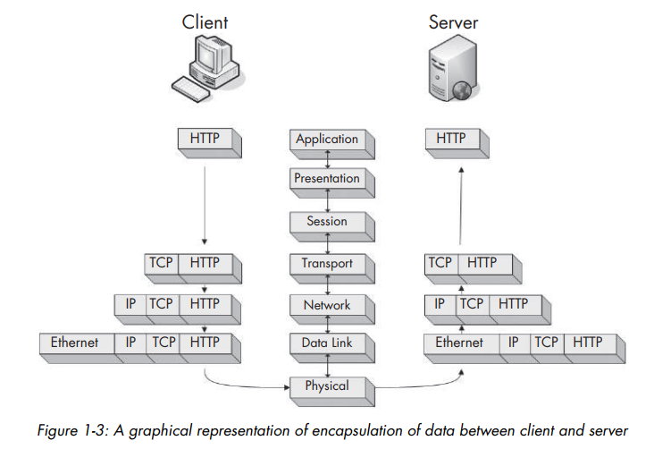
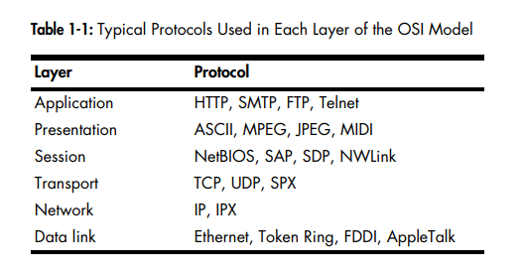
OSI Layers - Networks

Slide 5
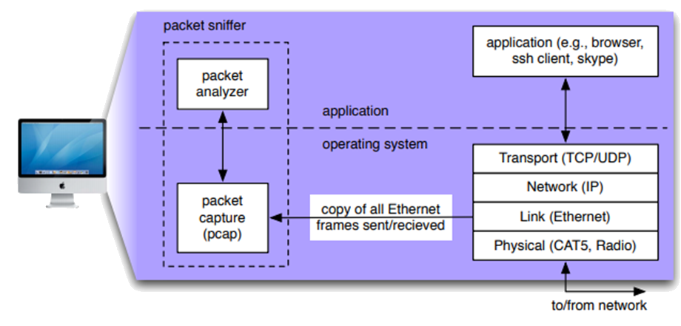
pCap

Slide 6
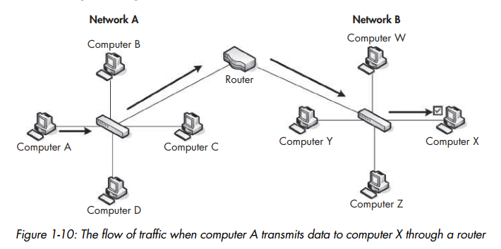

Routing

Slide 7
Wireshark is useful
What we can:
  Capture network traffic
  Decode packet protocols using dissectors
  Define filters – capture and display
  Watch smart statistics
  Analyze problems
  Interactively browse that traffic
Some examples people use Wireshark for:
  Network administrators: troubleshoot network problems
  Network security engineers: examine security problems
  Developers: debug protocol implementations
  People: learn network protocol internals

Slide 8
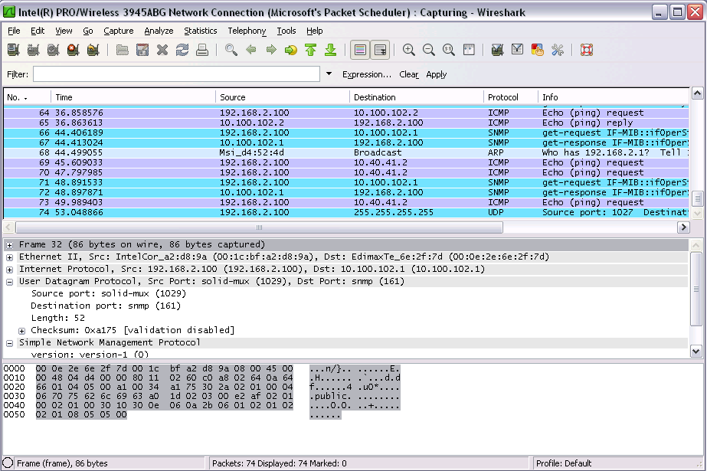
Wireshark
Packet
List
Packet
Details
Packet
Bytes

Slide 9
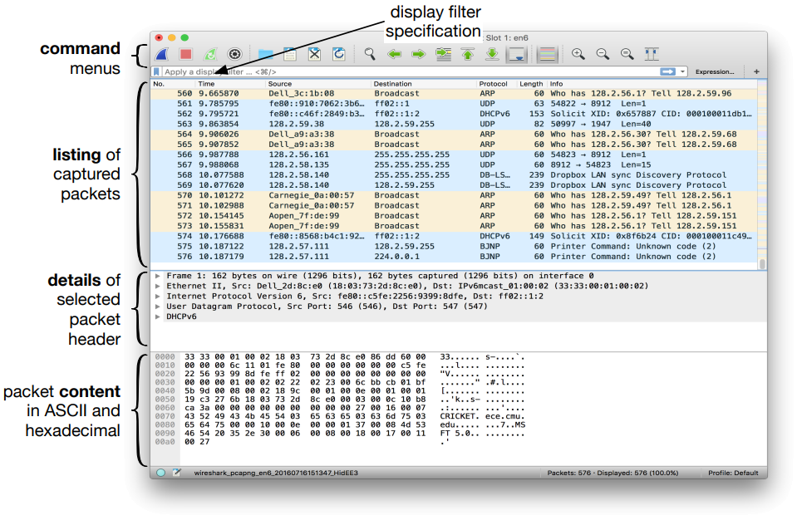
Wireshark 2

Slide 10
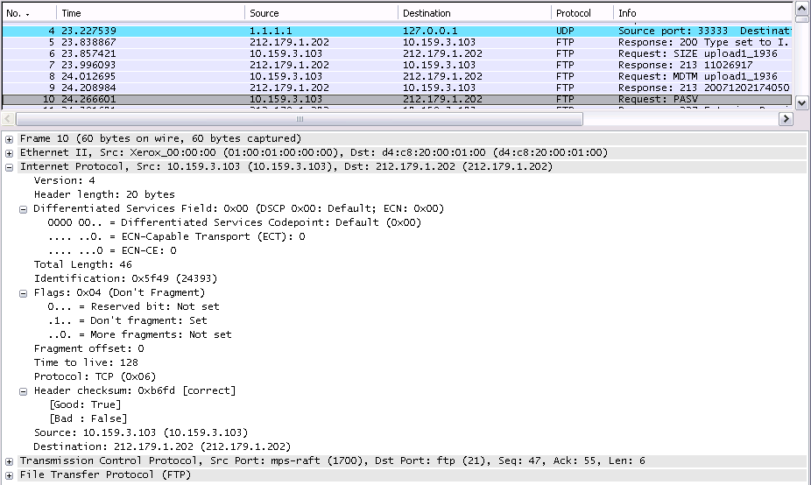
IP-packet example

Slide 11
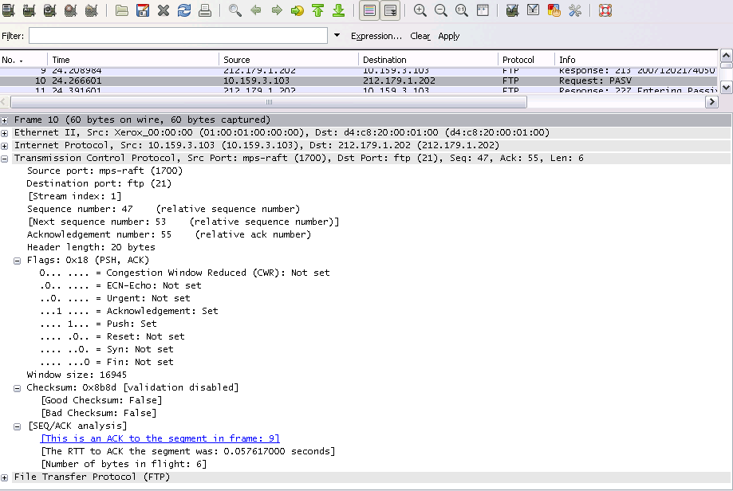
TCP Packet

Slide 12
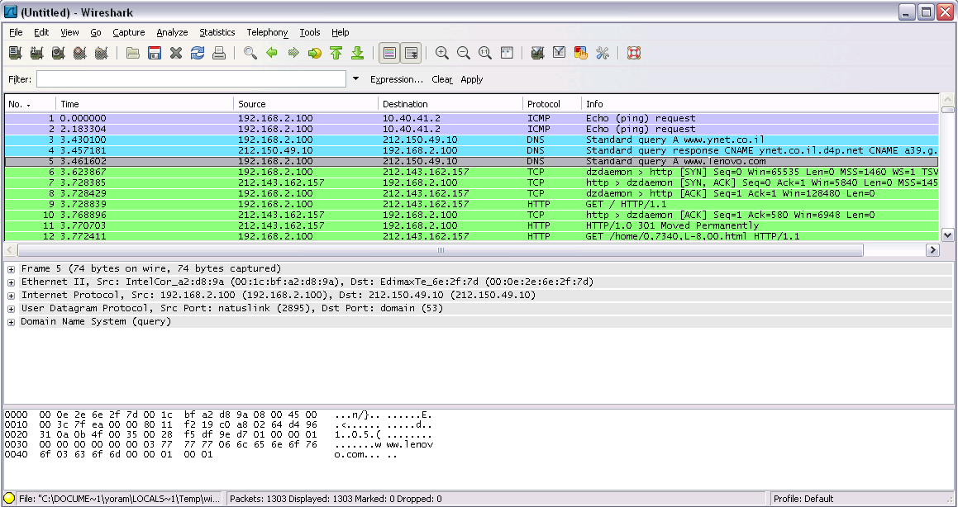
Flow Graph
SYN
SYN, ACK
ACK

Slide 13
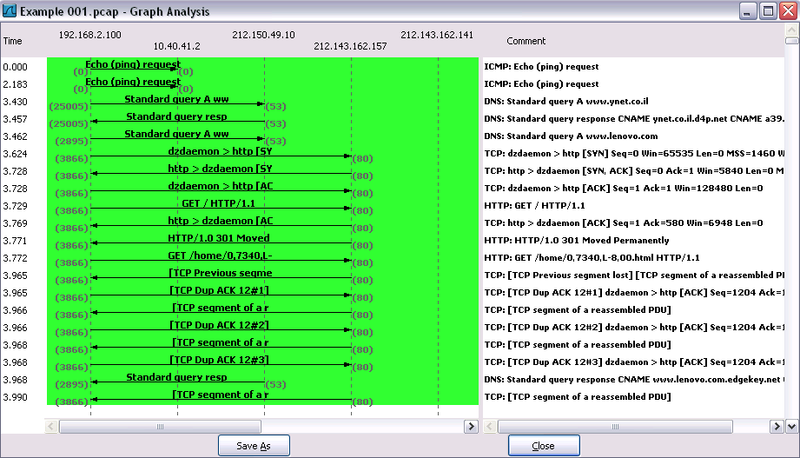
Flow Graph

