Slide 1
Security Lab 2
MAN IN THE MIDDLE ATTACK

Slide 2
Objectives
To understand ARP Poisoning, and how it forms MITM.
To understand DNS poisoning, and how it uses in the MITM.

Slide 3
Overview
Suppose that Alice, a high school student, is in danger of receiving a poor grade in math. Her teacher, Bob, mails a letter to Alice’s parents requesting a conference. However, Alice waits for the mail and removes the original letter from the mail box before her parents come home. She then replaces it with a counterfeit letter from Bob that compliments her for her math work. She also forges her parent’s signature on the original letter to decline a conference and then mails it back to Bob. The parents read the fake letter and compliment Alice on her hard work, while Bob wonders why her parents do not want a conference. Alice has conducted a Man-In-The-Middle attack by intercepting legitimate communication and forging a fictitious response to the sender.

Slide 4
Definition of MITM
Man-in-the-middle(MITM) attacks occur when the attacker manages to position themselves between the legitimate parties to a conversation.
The attacker spoofs the opposite legitimate party so that all parties believe they are actually talking to the expected other, legitimate parties.
A MITM attack allows the attacker to eavesdrop on the conversation between the parties, or to actively intervene in the conversation to achieve some illegitimate end.

Slide 5
Where MITM common?
MITM attacks are relatively uncommon in the wired Internet, since there are very few places where an attacker can insert itself between two communicating terminals and remain undetected.
For wireless links, however, the situation is quite different. Unless proper security is maintained on wireless last hop links, it can be fairly easy for an attacker to insert itself, depending on the nature of the wireless link layer protocol.

Slide 6
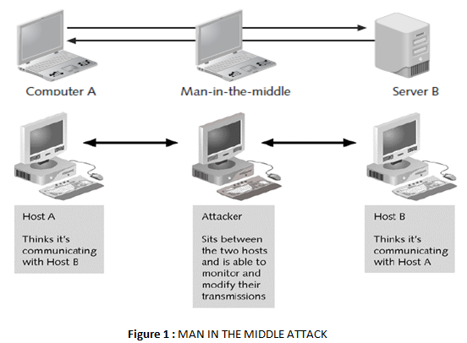
MITM Attack

Slide 7
Man-in-the-middle attack types
Man-in-the-middle attacks can be active or passive.
In a passive attack: the attacker captures the data that is being transmitted, records it, and then sends it on to the original recipient without his presence being detected.
In an active attack: the contents are intercepted and altered before they are sent on to the recipient.

Slide 8
The purpose of Man-In-The-Middle Attacks
Man-in-the-middle attacks have a variety of applications, including:
Web spoofing: This is an attack in which the assailant arranges his Web server between his victim’s Web browser and a legitimate server. In this case, the attacker can monitor and record the victim’s online activity, as well as modify the content being viewed by the victim.
TCP session hijacking: By arranging for traffic between two hosts to pass though his machine, an attacker can actually take over the role of one of them and assume full control of the TCP session. For example, by monitoring a victim’s communications with an FTP server, the attacker can wait for the victim to authenticate and then hijack the TCP session and take over the user’s access to the FTP server.

Slide 9
The purpose of Man-In-The-Middle Attacks
Information theft: The attacker can passively record data communications in order to gather sensitive information that might be passing between two hosts. This information could include anything from industrial secrets to username and password information.
Many other attacks, including denial-of-service attacks, corruption of transmitted data, or traffic analysis to gain information about the victim’s network.

Slide 10
Conducting man-in-the-middle attacks
Man-in-the-middle attacks can be accomplished using a variety of methods.
In fact, any person who has access to network packets as they travel between two hosts can accomplish these attacks:
ARP poisoning: Using Hunt, a freely available tool that uses ARP poisoning, an attacker can monitor and then hijack a TCP session. This requires that the attacker be on the same Ethernet segment as either the victim or the host with which it is communicating.

Slide 11
Conducting man-in-the-middle attacks
ICMP redirects: Using ICMP redirect packets, an attacker could instruct a router to forward packets destined for the victim through the attacker’s own machine. The attacker can then monitor or modify the packets before they are sent to their destination.
DNS poisoning: An attacker redirects victim traffic by compromising the victim’s DNS cache with incorrect hostname-to-IP address mappings.

Slide 12
Countermeasures
To protect against man-in-the-middle attacks, routers should be configured to ignore ICMP redirect packets. Countermeasures for ARP and DNS poisoning will be examined in the following discussion of spoofing techniques.

Slide 13
ARP poisoning
ARP (Address Resolution Protocol) poisoning is a technique used to corrupt a host’s ARP table, allowing the hacker to redirect traffic to the attacking machine. The attack can only be carried out when the attacker is connected to the same local network as the target machines.

Slide 14
ARP poisoning operation
ARP operates by sending out ARP request packets.
An ARP request broadcasts the question, “Whose IP address is x.x.x.x?” to all computers on the LAN, even on a switched network.
Each computer examines the ARP request and checks if it is currently assigned the specified IP.
The machine with the specified IP address returns an ARP reply containing its MAC address.
To minimize the number of ARP packets being broadcast, operating systems keep a cache of ARP replies.
When a computer receives an ARP reply, it will update its ARP cache with the new IP/MAC association.
ARP cache poisoning occurs when an attacker sends forged ARP replies.
In this case, a target computer could be convinced to send frames to the attacker’s PC instead of the trusted host.
When done properly, the trusted host will have no idea this redirection took place.

Slide 15
Example for ARP poisoning operation
First, the attacker would say that the router's IP address is mapped to his MAC address.
Second, the victim now attempts to connect to an address outside the subnet.
The victim has an ARP mapping showing that the router's IP is mapped to the hacker's MAC.
therefore, the physical packets are forwarded through the switch and to the hacker.
Finally, the hacker forwards the traffic onto the router.

Slide 16
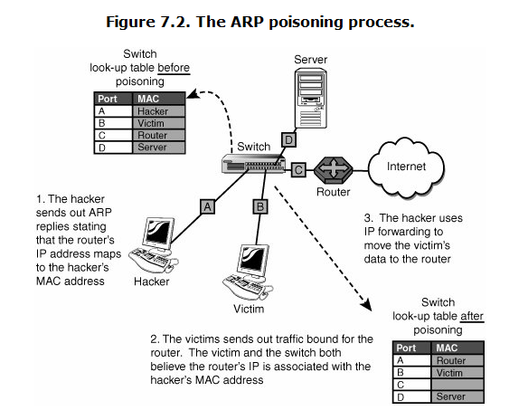
The ARP poisoning process

Slide 17
ARP poisoning
After this setup is in place, the hacker is able to pull off many types of man-in-the-middle attacks.
This includes passing on the packets to their true destination, scanning them for useful information, or recording the packets for a session replay later.
IP forwarding is a critical step in this process. Without it, the attack will turn into DoS.
IP forwarding can be configured as shown in Table 1.

Slide 18
IP Forwarding Configuration
Table 1. IP Forwarding Configuration
Operating System | Command | Syntax
Linux | Enter the following command to edit /proc: 1=Enabled, 0=Disabled | echo 1 >/proc/sys/net/ ipv4/ip_forward
Windows 2000, XP, and 2003 | Edit the following value in the registry: 1=Enabled, 0=Disabled | IPEnableRouter Location: HKLM\SYSTEM\ CurrentControlSet\ Services\Tcpip\ Parameters Data type: REG_DWORD Valid range: 0-1 Default value: 0 Present by default: Yes

Slide 19
tools for performing ARP spoofing attacks
There are many tools for performing ARP spoofing attacks for both Windows and Linux. A few are introduced here:
Arpspoof Part of the Dsniff package of tools written by Dug Song.
Arp spoof redirects packets from a target system on the LAN intended for another host on the LAN by forging ARP replies.

Slide 20
tools for performing ARP spoofing attacks
Ettercap One of the most feared ARP poisoning tools because Ettercap can be used for ARP poisoning, for passive sniffing, as a protocol decoder, and as a packet grabber.
It is menu driven and fairly simple to use.
As an example, ettercapNzs will start ettercap in command-line mode (-N), not perform an ARP storm for host detection (-z), and passively sniff for IP traffic (-s).
This will output packets to the console in a format similar to Windump or Tcpdump.
Ettercap exits when you type q.
Ettercap can even be used to capture usernames and passwords by using the C switch.
Other common switches include: N is Non-interactive mode, z starts in silent mode to avoid ARP storms, and a is used for ARP sniffing on switched networks.

Slide 21
Countermeasures
To stop ARP poisoning, use network switches that have MAC binding features.
Switches with MAC binding store the first MAC address that appears on a port and do not allow the mapping to be changed without authentication.

Slide 22
DNS poisoning
DNS spoofing manipulates the DNS server to redirect users to an attacker’s server.
The DNS server resolves Internet domain names (www.google.com) to IP addresses(74.125.230.144), taking the burden off the user to remember a series of numbers.
DNS spoofing can alter the cache so that www.google.com, which normally translates to an IP address of 74.125.230.144, is redirected to 72.30.2.43 (yahoo.com).

Slide 23
Ways of DNS Spoofing
DNS spoofing is accomplished in one of three ways:
The attacker compromises the victim organization’s Web server and changes a hostname-to-IP address mapping. When users request the hostname, they redirected to the hacker’s server, rather than the authentic one.
Using IP spoofing techniques, the attacker’s DNS server instead of the legitimate DNS server answers lookup requests from users. Again, the hacker can direct user lookups to the server of his or her choice instead of to the authentic server (also called DNS hijacking).

Slide 24
Ways of DNS Spoofing
When the victim organization’s DNS server requests lookups from authoritative servers, the attacker “poisons” the DNS server’s cache of hostname-to-IP address mappings by sending false replies. The organization’s DNS server stores the invalid hostname-to-IP address mapping and serves it to clients when they request a resolution.
All three attacks can cause serious security problems, such as redirecting clients to wrong Internet sites or routing e-mail to non-authorized mail servers.

Slide 25
Countermeasures
To prevent DNS spoofing:
Ensure that your DNS software is the latest version, with the most recent security patches installed.
Enable auditing on all DNS servers.
Secure the DNS cache against pollution.

